Slide 1
Label Definition (LAD) (Customer Record folder)
A. Label Definition – LAD
B. Copying and Transferring
C. Immediate Validation Results – IVR
D. CPR Sections
SMS/800 ® is a registered trademark of SMS/800, Inc.
Notes:
Label Definitions is our next Module. We will look at:
(Click)
A. Label Definition – LAD
B. Copying and Transferring
C. Immediate Validation Results – IVR
D. CPR Sections

Slide 2
Label = “Shorthand” (2 Types)
Shorthand way of entering Data
LAD
On CPR only
“*” Required
CR specific
ASL
On CAD only
No “*”
Global
Notes:
A Label is a shorthand way of entering information into a CAD. There are 2 types of Labels. A LAD label
(Click)
and an ASL Label.
(Click)
A LAD label can only be entered in a CPR. An Asterisk is required and it is CR specific
(Click)
An ASL label can only be entered in a CAD. No Asterisk is required and it becomes a Global table
(Click)

Slide 3
LAD – 9 Type/Part Tabs
Asterisk “*” By name indicates there are entries in the Tab
LAD Type | Definition
1. Area code | Valid 3-digit area code entry. (Originating NPA)
2. Date | Valid date entry in the format mm/dd. (Originating)
3. LATA | Valid 3-digit LATA entry. (Originating)
4. NXX | Valid 3-digit NPA and NXX entry. (Originating)
5. State | Valid 2-character state code. (Originating)
6. Tel# | One valid 10-digit (Destination) telephone number. (Destination)
7. Time | Valid time in the format hh:mm(A/P)-hh:mm(A/P) range. (Originating)
8. 10-digit# | Valid 10 digit (Originating) number. Example: 201-699-1234
9. 6-digit# | Valid 6 digit (Originating) number. Example: 201-699
Notes:
There are 9 Types of LAD labels. Each occupies its own Tab of the Lad screen.
(Click)
Displayed is the 6-digit type.
(Click)
1. Area code
Valid 3-digit area code entry. (Originating NPA)
(Click)
2. Date
Valid date entry in the format mm/dd. (Originating)
(Click)
3. LATA
Valid 3-digit LATA entry. (Originating)
(Click)
4. NXX
Valid 3-digit NPA and NXX entry. (Originating)
(Click)
5. State
Valid 2-character state code. (Originating)
(Click)
6. Tel#
One valid 10-digit (Destination) telephone number. (Destination)
(Click)
7. Time
Valid time in the format hh:mm(A/P)-hh:mm(A/P) range. (Originating)
(Click)
8. 10-digit#
Valid 10 digit (Originating) number. Example: 201-699-1234
(Click)
9. 6-digit#
Valid 6 digit (Originating) number. Example: 201-699
(Click)
An Asterisk by the name in the TAB indicates that there are entries in the TAB.
(Click)
(Click)

Slide 4
LAD - Action Buttons
Insert Cell - Used to insert a cell to left of where cursor is placed.
Delete Cell - Used to delete a single cell.
Delete Row - Used to delete an entire row.
Delete Type - Used to delete entire displayed type/part of the LAD Label.
Search - Used to search the LAD Label on display.
Retrieve - Used to display the LAD of the Dial Number.
Update, Save, Copy, Transfer – Buttons to complete the action
Delete - Used to delete the ENTIRE Label. (all 9 types)
CAD - Used to access the CAD window.
CPR - Used to access the CPR window.
Revert – Reverts back to the last saved version of the record.
Clear – Clears the data from the screen (Get out of the record)
Close – Closes the LAD window
Notes:
The Action buttons below the LAD table include:
(Click)
Insert Cell – inserts a cell to the left of where the cell has been selected
Delete Cell – deletes whatever cell is selected and shifts all cells to the left.
Delete Row – Deletes the row where a cell is selected.
Delete Type – Deletes the data for the entire LAD type that is being viewed.
Search – Searches only the current viewed Tab (Lad type) for the entry in the field.

Slide 5
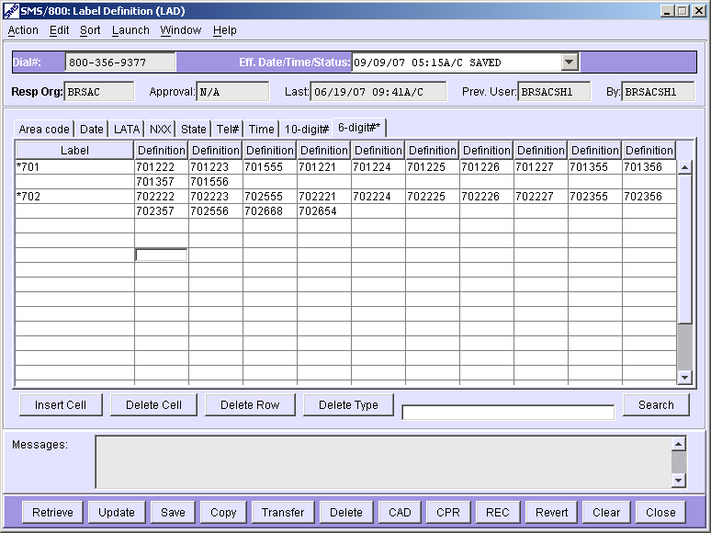
Create a Label Definition
1. Access the LAD window for a customer record with an existing CAD.
2. Select the Label Type TAB on the LAD window. (I.E. 6-digit)
3. Enter an asterisk (*) and label name in the Label (name) field. Label name can be 2-8 characters including the Asterisk.
4. Enter the information in the Definition per each cell. (255 per name)
5. Save or Update to store the data. Partial Save can be used if LAD is incomplete. Select Menu item Action – then Partial Save.
Notes:
To Create a new LAD Label Definition follow these steps:
(Click)
Access the LAD window for a customer record with an existing CAD.
(Click) (Click)
2. Select the Label Type Tab on the LAD window. (I.E. 6-digit)
(Click)(Click)
3. Enter an asterisk (*) and label name in the Label (name) field. Label name can be 2-8 characters including the Asterisk.
(Click)(Click)
4. Enter the information in the Definition per each cell. (255 per name)
(Click)(Click)
5. Save or Update to store the data. Partial Save can be used if LAD is incomplete. Select Menu item Action – then Partial Save.
(Click)(Click)

Slide 6
Add a New Label Type & Label Name
1. Retrieve the desired Future dated LAD.
2. Select the Label Type tab. (i.e. Tel#)
3. Enter the label name in the Label column. (2-8 characters including *)
4. Enter the information in the Definition field(s). (255 max)
5. Save or Update to store the data. Partial Save can be used if LAD is incomplete. Select Menu item Action – then Partial Save or Ctr+E.
Notes:
To Add a new lad or label name:
(Click)
Retrieve the desired Future dated LAD.
(Click)(Click)
2. Select the Label Type tab. (i.e. Tel#)
(Click)(Click)
3. Enter the label name in the Label column. (2-8 characters including *)
(Click)(Click)
4. Enter the information in the Definition field(s). (255 max)
(Click)(Click)
5. Save or Update to store the data. Partial Save can be used if LAD is incomplete. Select Menu item Action – then Partial Save or Ctr+E.
(Click)(Click)

Slide 7
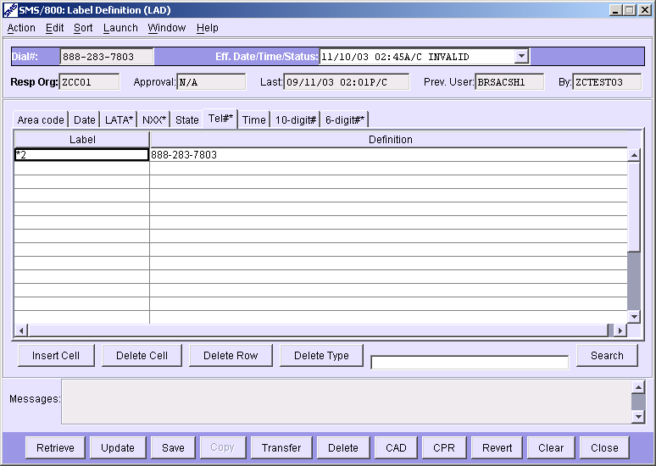
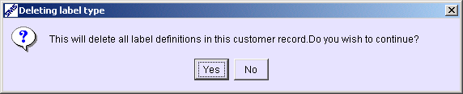
Delete an Entire LAD
1. Retrieve the desired LAD for a customer record.
2. Click the Delete button (bottom row of window).
3. Click the Yes button.
Notes:
To Delete an Entire LAD…
(Click)
Retrieve the desired LAD for a customer record.
(Click)
2. Click the Delete button (bottom row of window).
(Click) (Click)
3. Click the Yes button.
(Click)

Slide 8

Delete a Label Type
1. Retrieve the desired LAD for a customer record.
2. Select the Label Type tab to be deleted.
3. Click the Delete Type button (middle row of window).
4. Click the Yes button.
Notes:
To delete just one Label type (Tab):
(Click)
Retrieve the desired LAD for a customer record.
(Click)
2. Select the Label Type tab to be deleted.
(Click)
3. Click the Delete Type button (middle row of window).
(Click)
4. Click the Yes button.
(Click)

Slide 9
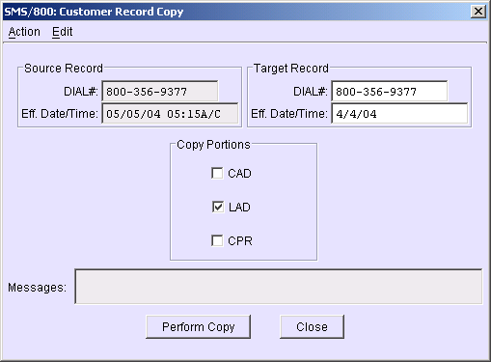
Copy the Entire LAD to a Different Key
1. Retrieve the Source Record in the LAD window.
2. Click the Copy button or (CTRL + Y).
3. Enter (or confirm) the Target Record Dial# and Eff. Date/Time.
4. Check the LAD box.
5. Click the Perform Copy button.
Notes:
To copy the Entire LAD to a different Toll Free number…
(Click)
Retrieve the Source Record in the LAD window.
(Click)(Click)
2. Click the Copy button or (CTRL + Y).
(Click)(Click)
3. Enter (or confirm) the Target Record Dial# and Eff. Date/Time.
(Click)(Click)
4. Check the LAD box.
(Click)(Click)
5. Click the Perform Copy button.
(Click)(Click)

Slide 10
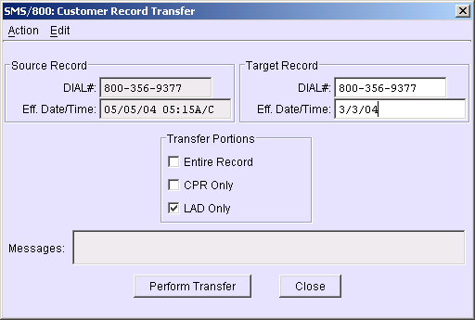
Transfer the Entire LAD to a Different Key
1. Retrieve the Source Record.
2. Click the Transfer button or (CTRL + T) to bring up the Transfer window.
3. Enter (or confirm) the Target Record Dial# and/or Eff. Date/Time.
4. Check the LAD Only box.
5. Click the Perform Transfer button.
Notes:
To Transfer a Lad to a different Customer Record…
(Click)
Retrieve the Source Record in the LAD window.
(Click)(Click)
2. Click the Transfer button or (CTRL + T).
(Click)(Click)
3. Enter (or confirm) the Target Record Dial# and/or Eff. Date/Time.
(Click)(Click)
4. Check the LAD Only box.
(Click)(Click)
5. Click the Perform Transfer button.
(Click)(Click)

Slide 11
Search Label Definitions
1. Enter the search word/number in the search text box.
2. Click the Search button.
3. WBA will highlight the search word/number.
Notes:
To Search for an entry on a LAD table on display….
(Click) (Click)
Enter the search word/number in the search text box.
(Click) (Click)
2. Click the Search button.
(Click) (Click)
3. WBA will highlight the search word/number.
(Click) (Click)

Slide 12
Sort Label Definitions
1. Access the LAD window.
2. Select Sort from the menu.
3. (3 ways to sort) Select LAD (all types),Type (single type), or Label (single name)
Notes:
To Sort Label definitions…
Access the LAD window.
(Click) (Click)
Select Sort from the menu.
(Click)
(3 ways to sort) Select LAD (all types)
(Click)
Type (single type)
(Click)
or Label (single name)
(Click)

Slide 13
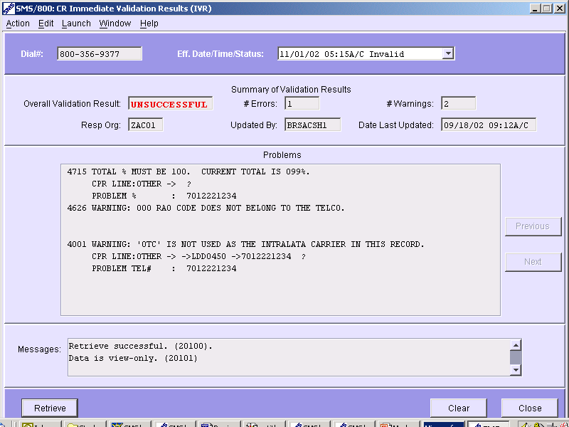
IVR – Immediate Validation Results
The IVR is accessed from the “Launch”Menu item at the top of the CAD, CPR or LAD (Customer Record) screens. (expanded Messages field)
Result
#Errors
#Warnings
Resp Org
Who
When
Previous
Next
Messages
Launch
Problems:
Total must be 100%. Next to CPR row OTHER under % column terminating at 701- 222-1234
Notes:
The IVR screen is an expanded version of the Messages field found at the bottom of the CR screens.
(Click) (Click)
The IVR is accessed from the “Launch”Menu item at the top of the CAD, CPR or LAD (Customer Record) screens.
(Click) (Click)
IVR will display the:
(Click)
The Overall Results, #Errors, #Warnings, Resp Org ID, Who updated, When Updated, Prevous page, Next page and messages,
(Click)
Problems – I.e. (Total Total must be 100%. Next to CPR row OTHER under % column terminating at 701- 222-1234)
(Click)

Slide 14
CPR Main Sections
CPR Main Sections can be built to stand side by side. The first column needs to be the same Criteria. Main Sections must start with the letter M.
1. Select Add Section
2. Enter name starting with M - OK
MainMT
3. Build the CPR – Save/Update
Notes:
CPR Main Sections…
(Click)
CPR Main Sections can be built to stand side by side.
The first column of each CPR Main needs to be the same (header) Criteria.
Main Sections Names must start with the letter M.
(Click)
The default Name for a section is “Main”. To create another Main…
(Click) Select Add Section
(Click) Enter Name starting with M – OK
(Click) Build the new CPR (First column needs to be the same on all Multiple Mains.
Save or Update your record.

Slide 15
CPR Sub Sections
CPR Sub sections can be built for the GoTo Column Header. Sub Section names belong under column header of GoTo. Sub Section names must start with the letter S.
1. Select Add Section
2. Build the Sub Section(s) - Enter name starting with S - OK
3. Enter Sub Section name in Go To column of Main section - Save/Update
Notes:
CPR Sub Sections…
CPR Sub sections can be built for the GoTo Column Header.
Sub Section names only belong under the column header of GoTo.
(Click)
Sub Section names must start with the letter S. (i.e. SUB1)
(Click)
To build a Sub Section; Select Add Section
(Click)
Build the Sub Section(s) Enter name starting with S – OK
(Click) (Click)
Enter the Sub Section Name in the Go To column of the Main Section – Save or Update
(Click)

Slide 16
LAD Review
LAD Window
LAD Parts (9 types)
Create a new LAD
ADD a Label name
Delete an Entire LAD or LAD Type
Copy and Transfer LAD
Search in LAD
Sort LAD
IVR
CPR Sections
Written Exercise LAD #5
Hands-On Exercises LAD (5A–5C)
Notes:
Complete the Written and Hands- On Exercises for the LAD Module.

